Slide 1
AIRLINE ANALYSIS
H JAYANT
2320787

Slide 2
INTRODUCTION
In the modern aviation industry, data-driven insights are paramount for optimizing operations, enhancing customer experiences, and driving strategic decision-making. Our project delves into a comprehensive analysis of airline data, leveraging advanced techniques to extract valuable insights.
Our dataset encompasses a wide array of attributes, including flight details, airline specifications, and temporal data. Notably, we have parsed the "Airport Region" attribute to discern country and continent categories, providing deeper geographical insights into airline operations. Additionally, our parsing of "Departure Date" and "Arrival Date" enables granular temporal analysis, facilitating trend identification and anomaly detection.

Slide 3
In our pursuit of data quality, we assign dimensions to key attributes. "Travel Time" serves as a metric for accuracy, capturing the duration between departure and arrival. "Airline Name" is scrutinized for validity, ensuring the integrity of airline specifications. Moreover, we assess the completeness of "Departure Date" and "Arrival Date" to ensure data integrity.
By leveraging Informatica Data Quality (IDQ) and Informatica PowerCenter, we orchestrate a seamless data integration workflow. Through data profiling, scorecard analysis, parsing, and standardization, we aim to unlock actionable insights and drive operational excellence in the aviation industry.

Slide 4
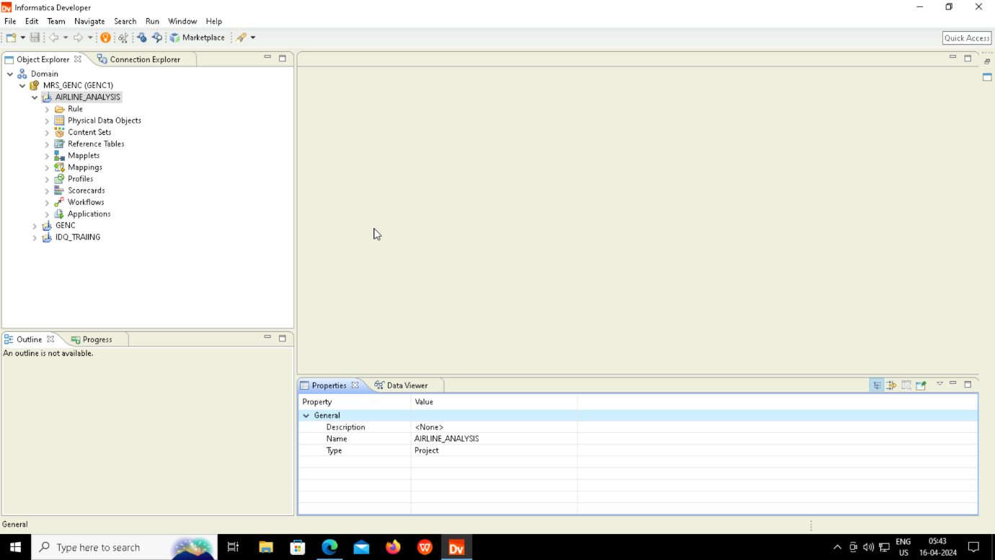
IDQ DEVELOPER

Slide 5
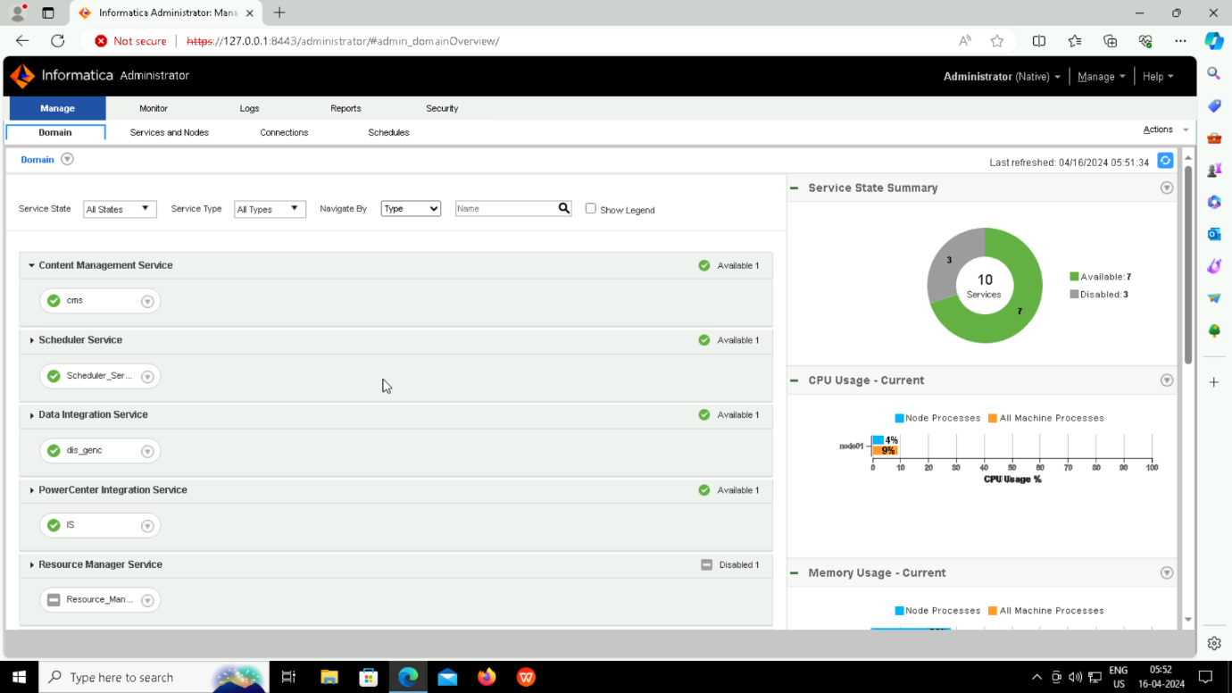
IDQ ADMIN

Slide 6
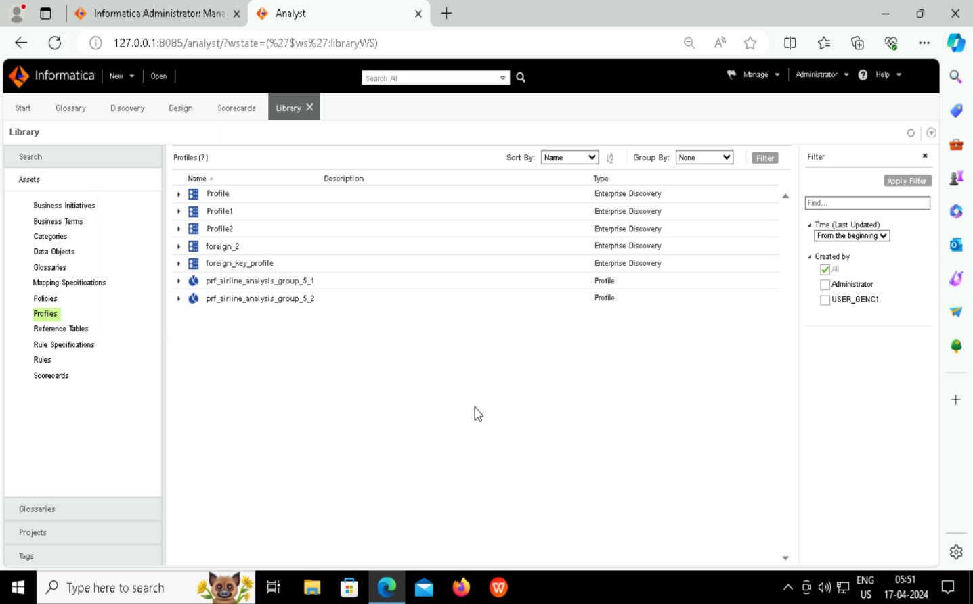
IDQ ANALYST

Slide 7
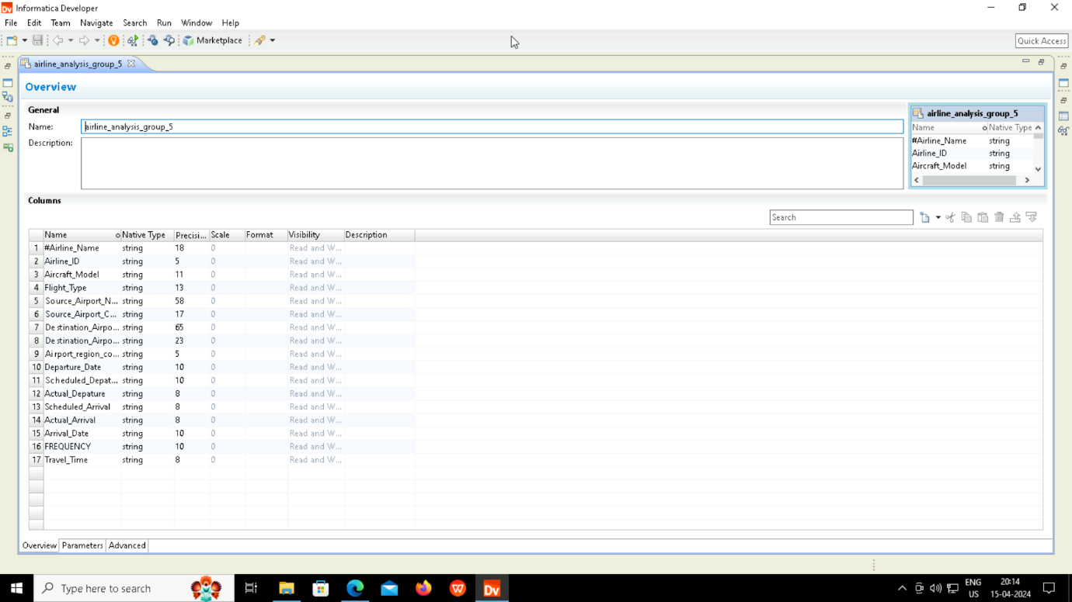
SOURCE PDO

Slide 8
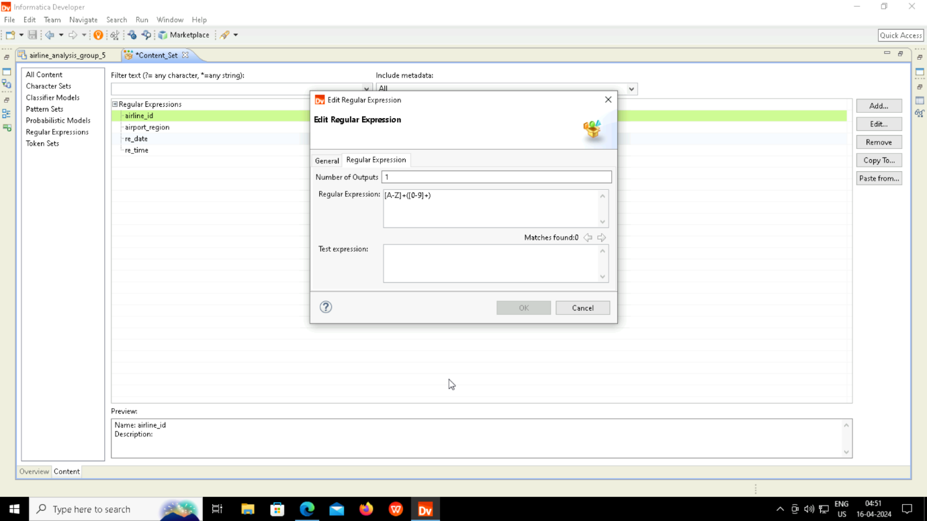
CONTENT SET

Slide 9
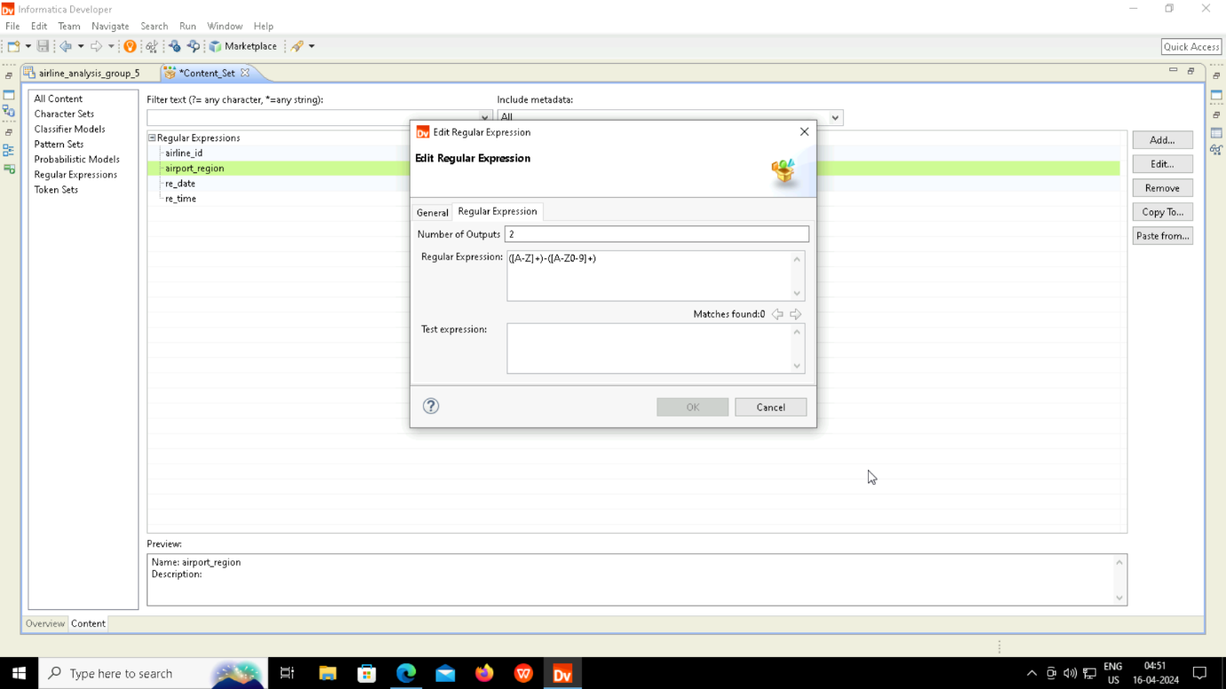

Slide 10
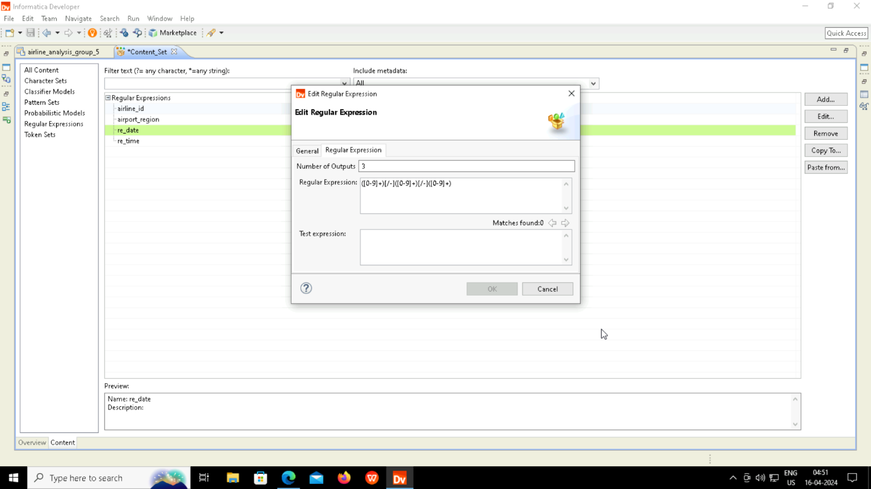

Slide 11
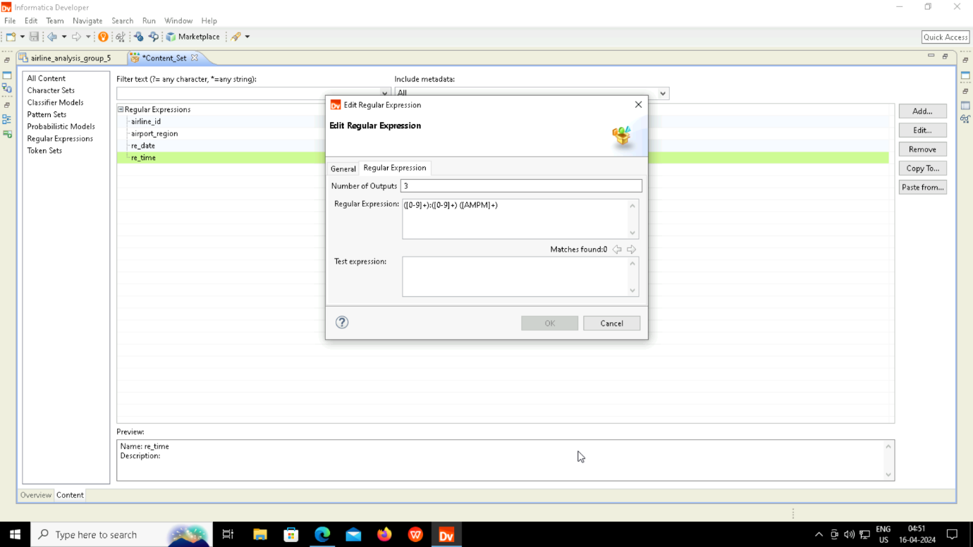

Slide 12
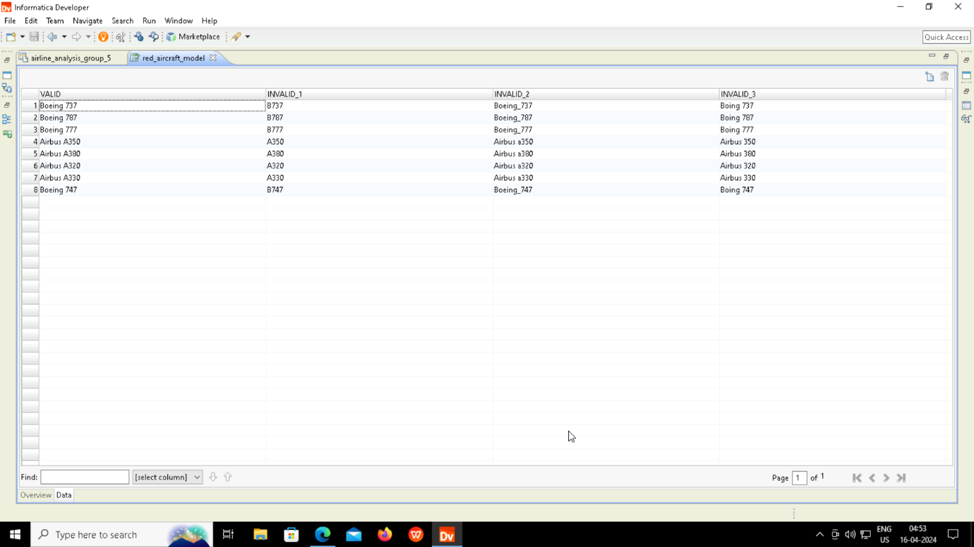
REFERENCE TABLE

Slide 13
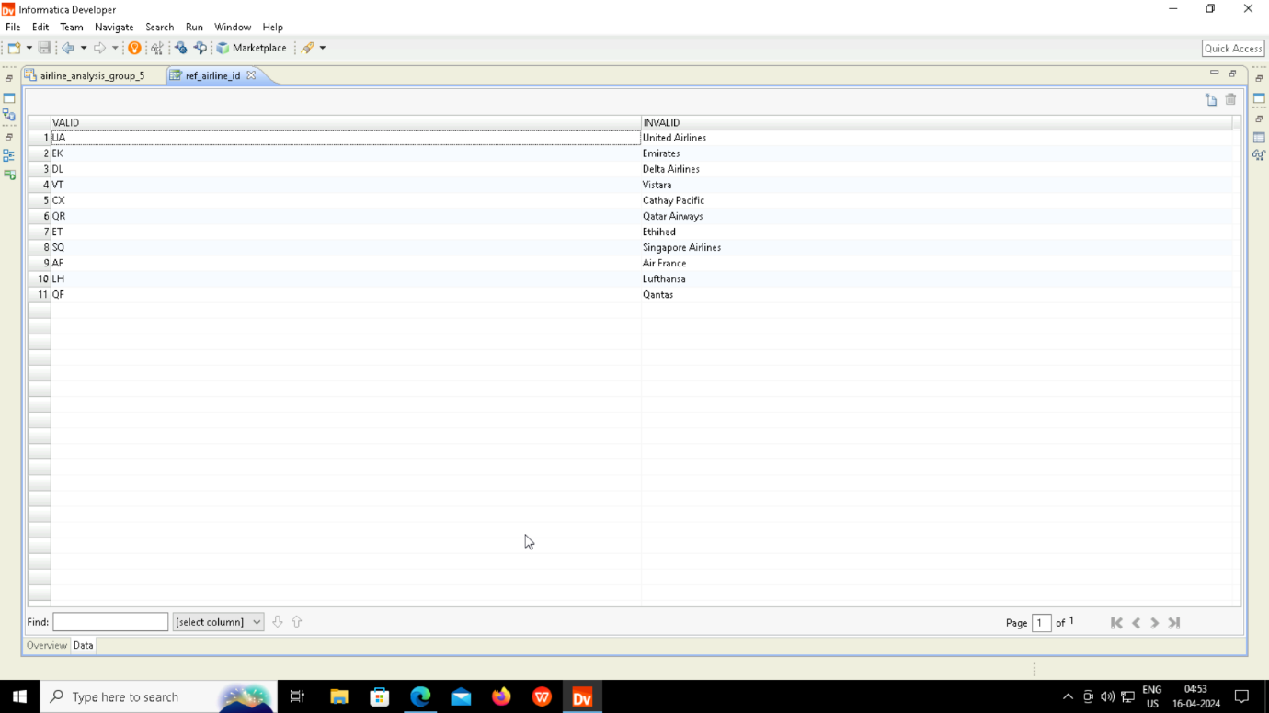

Slide 14
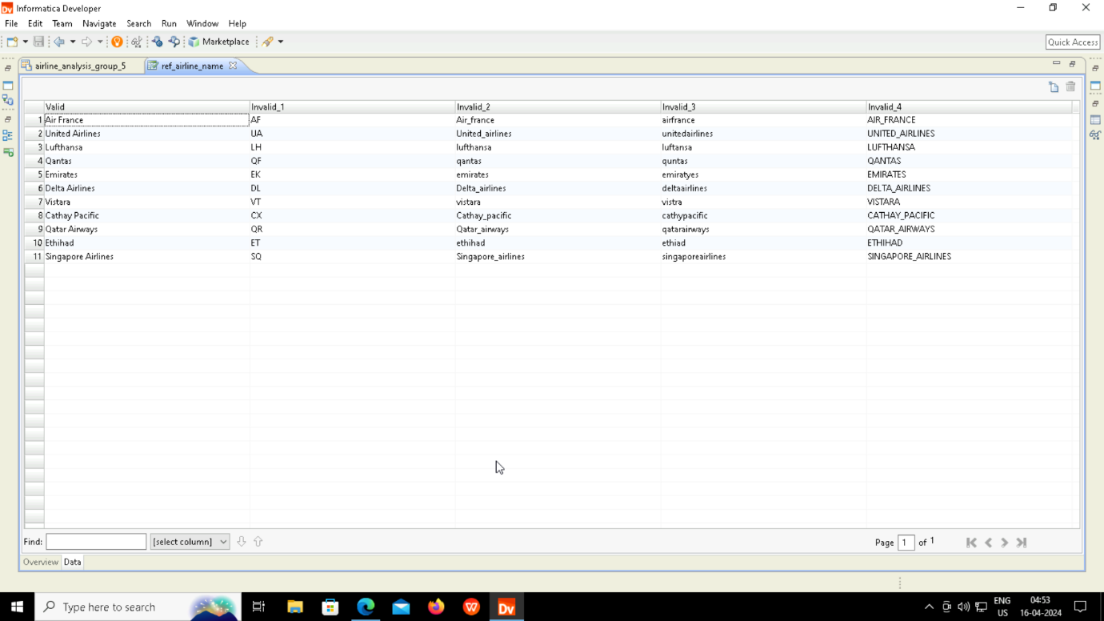

Slide 15
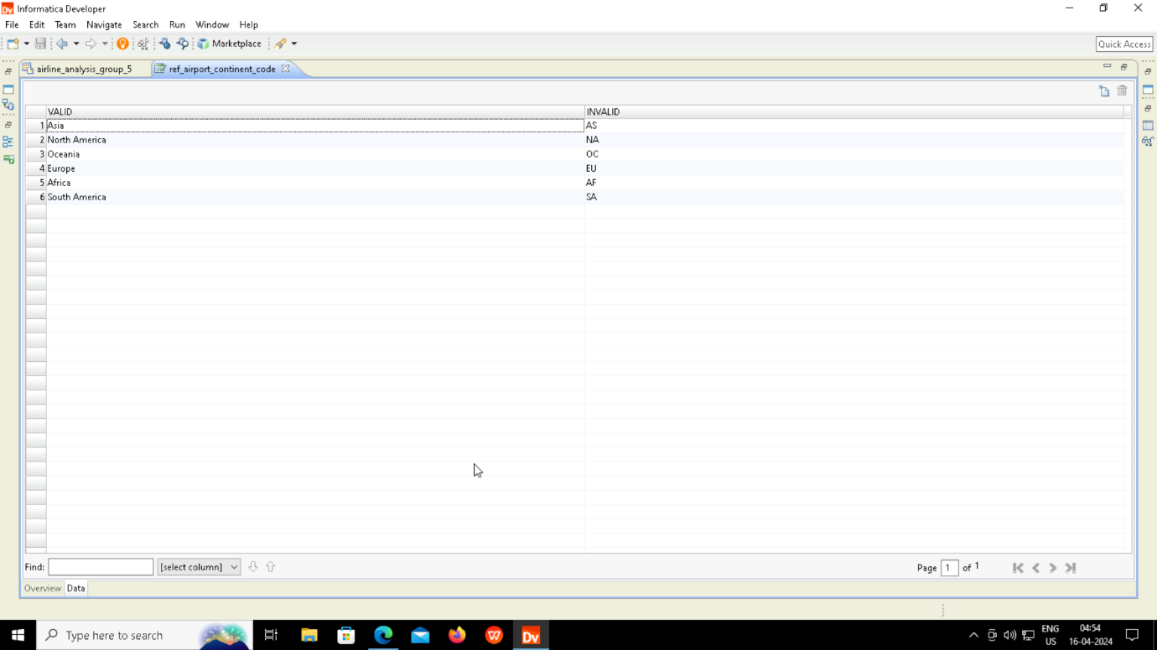

Slide 16
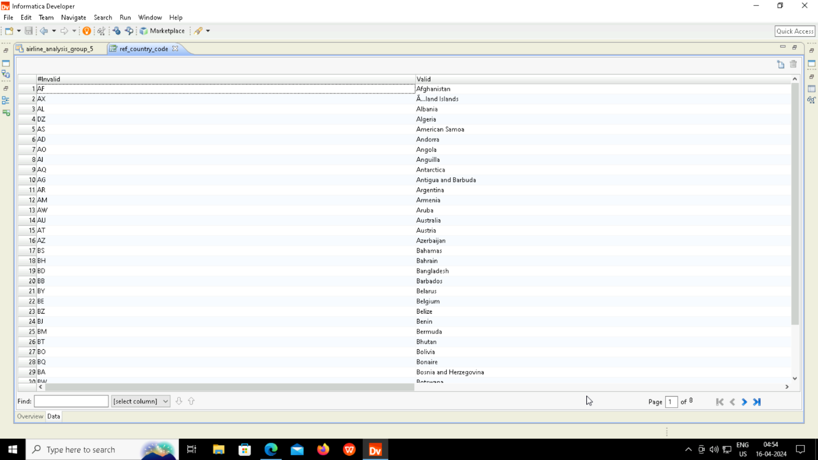

Slide 17
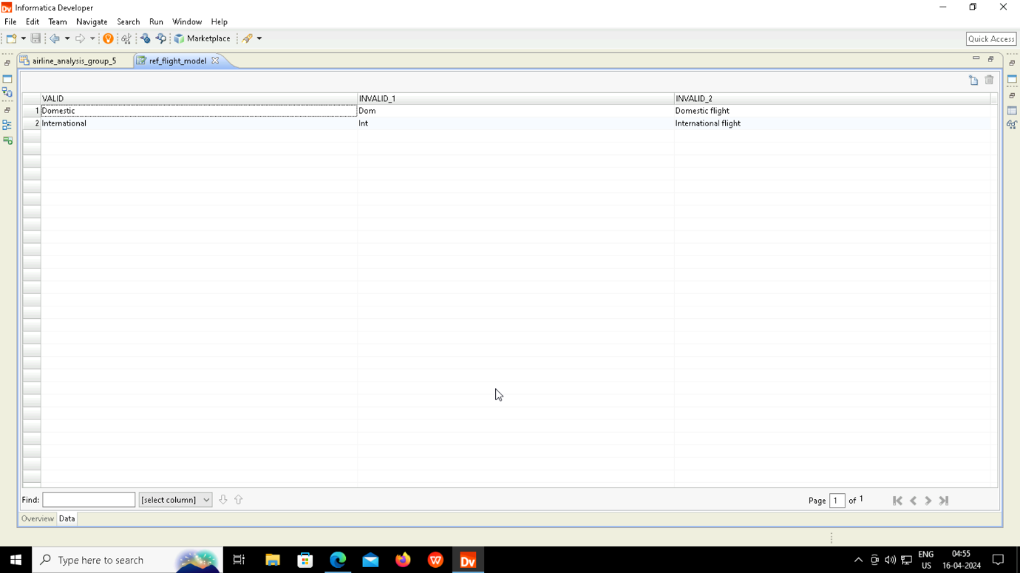

Slide 18
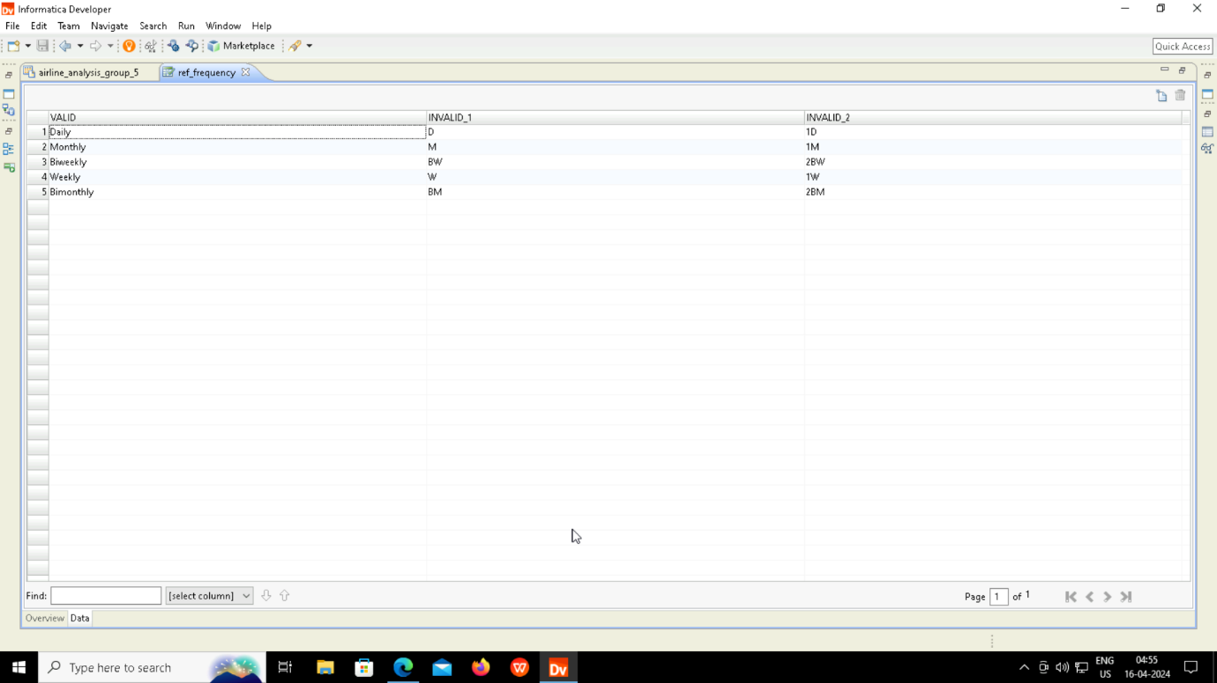

Slide 19
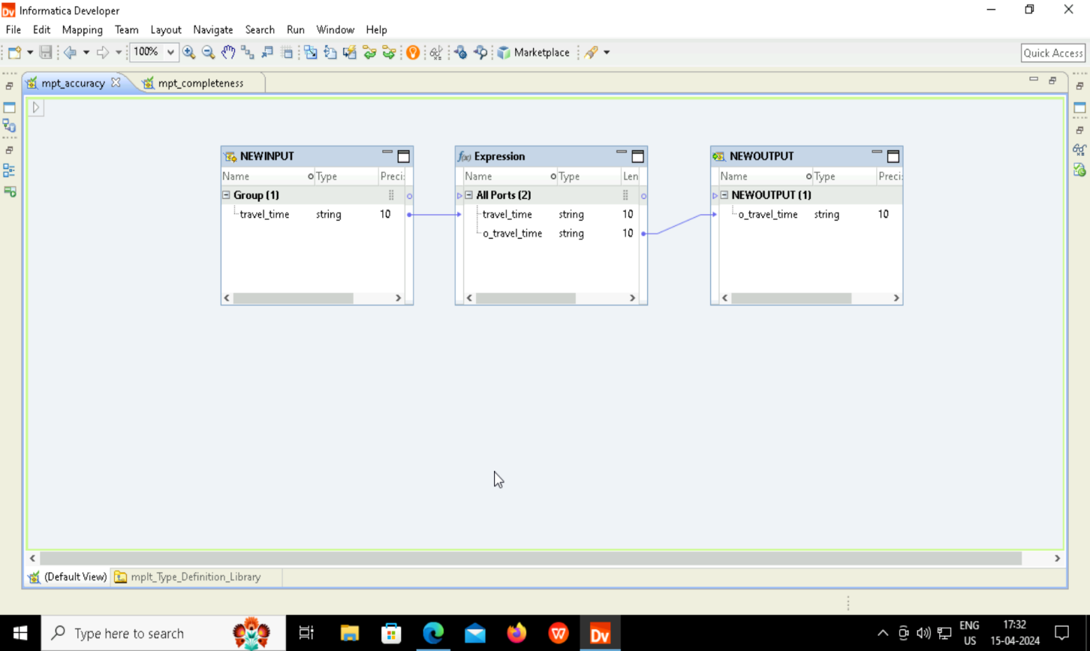
RULE

Slide 20
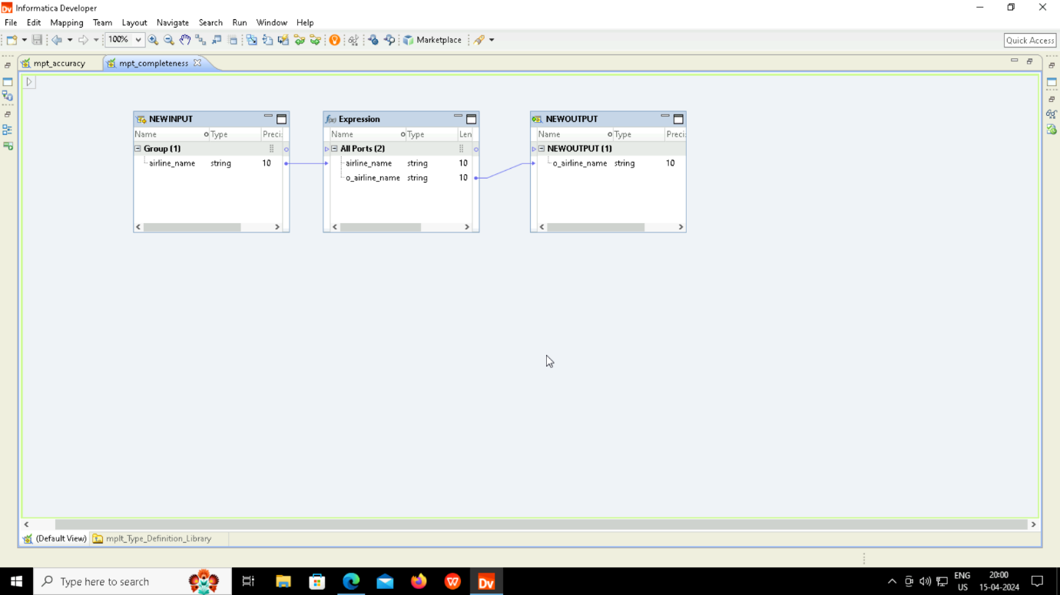

Slide 21
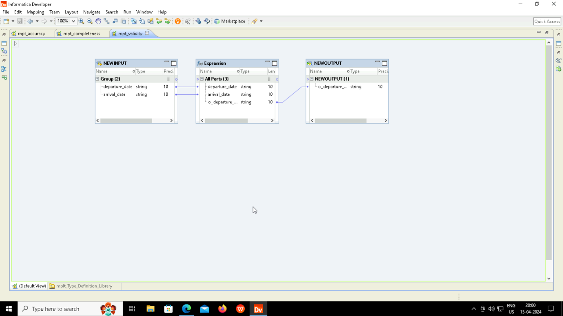

Slide 22
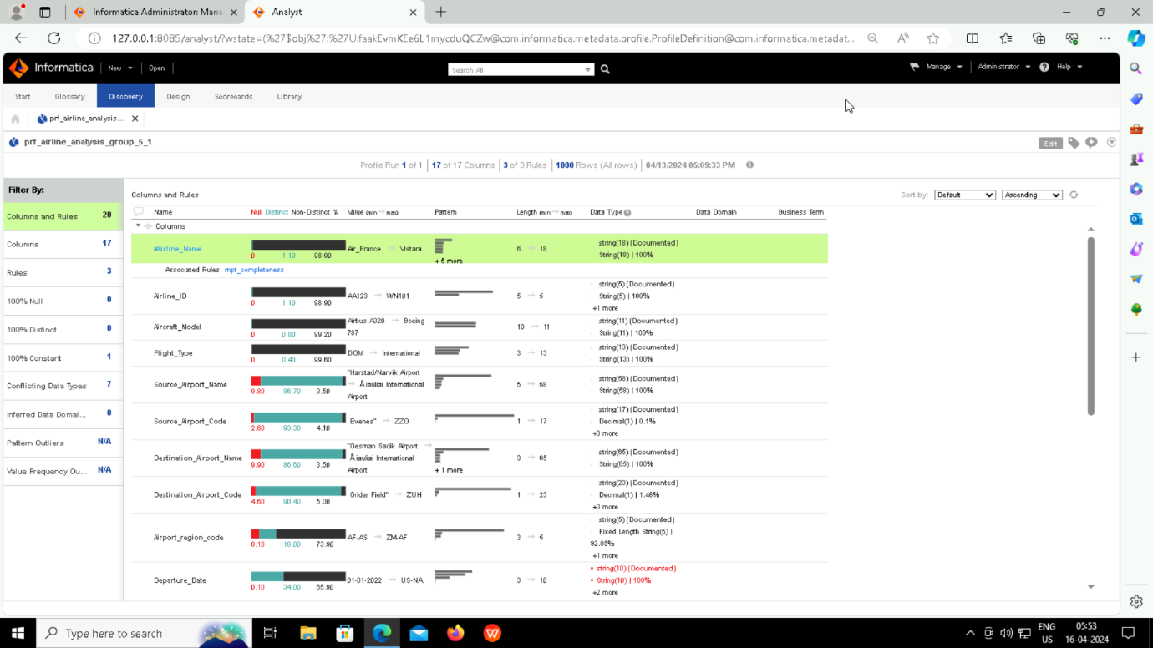
PROFILE (BEFORE CLEANING)

Slide 23
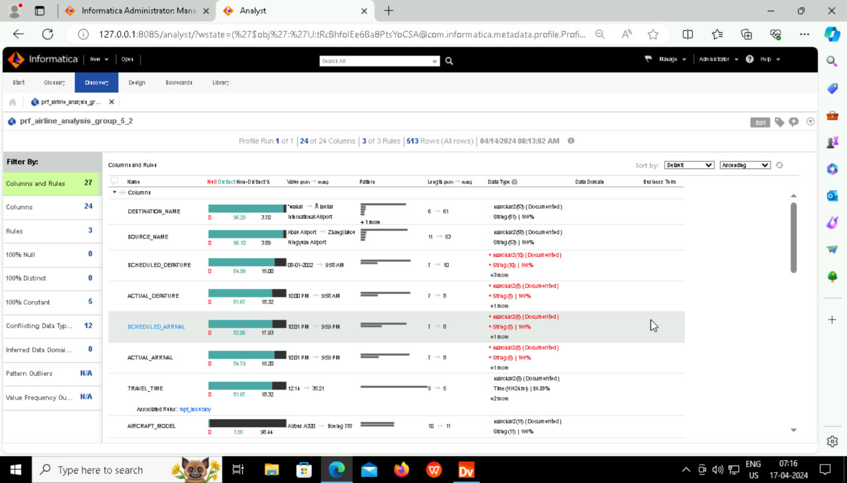
PROFILE (AFTER CLEANING)

Slide 24
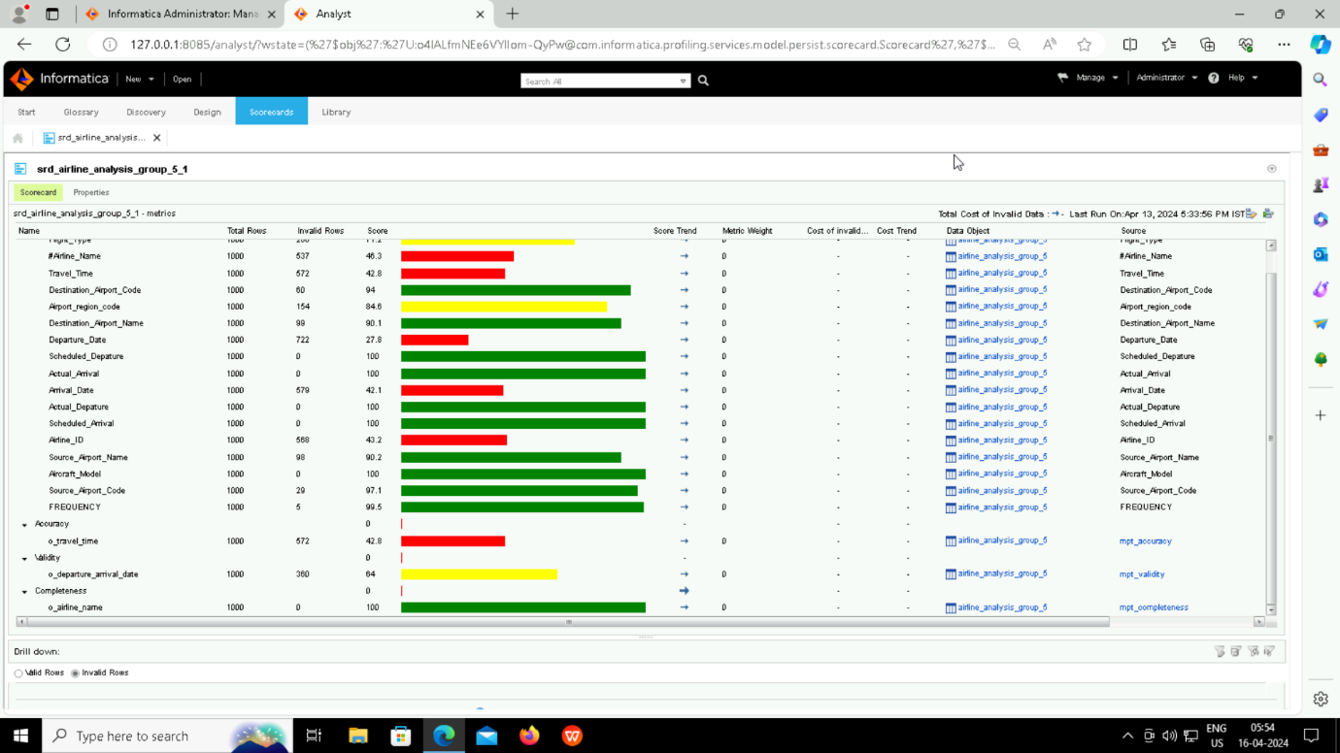
SCORECARD (BEFORE CLEANING)

Slide 25
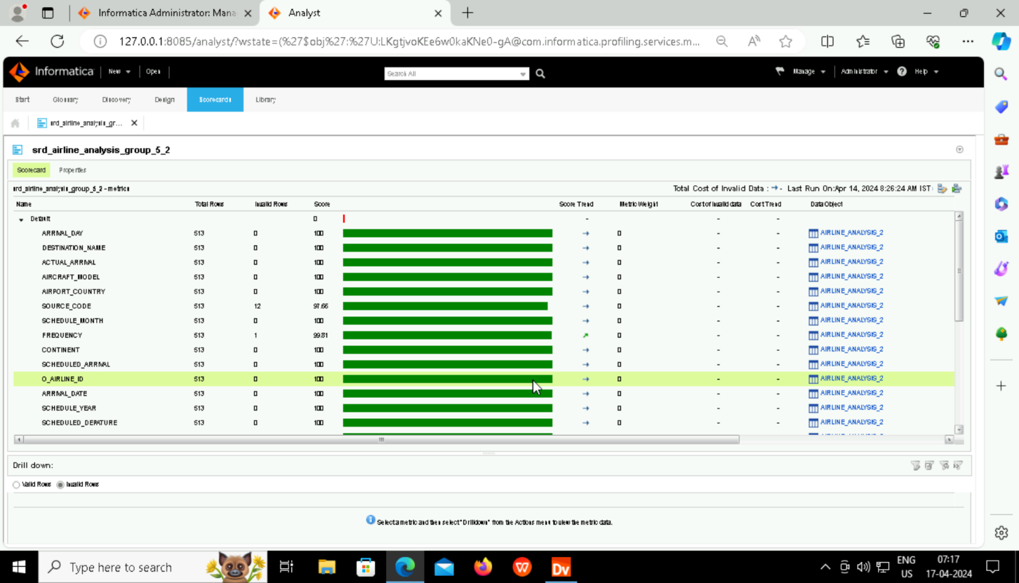
SCORECARD (AFTER CLEANING)

Slide 26
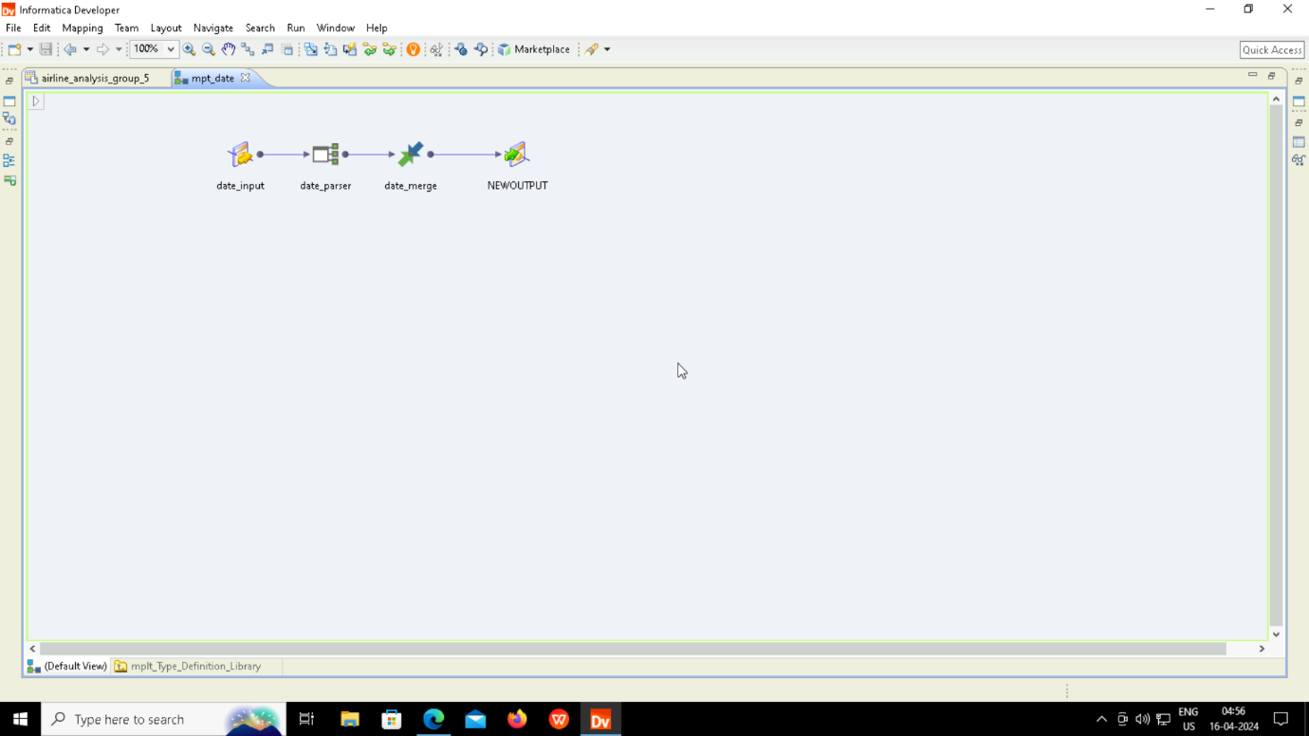
MAPPLET

Slide 27
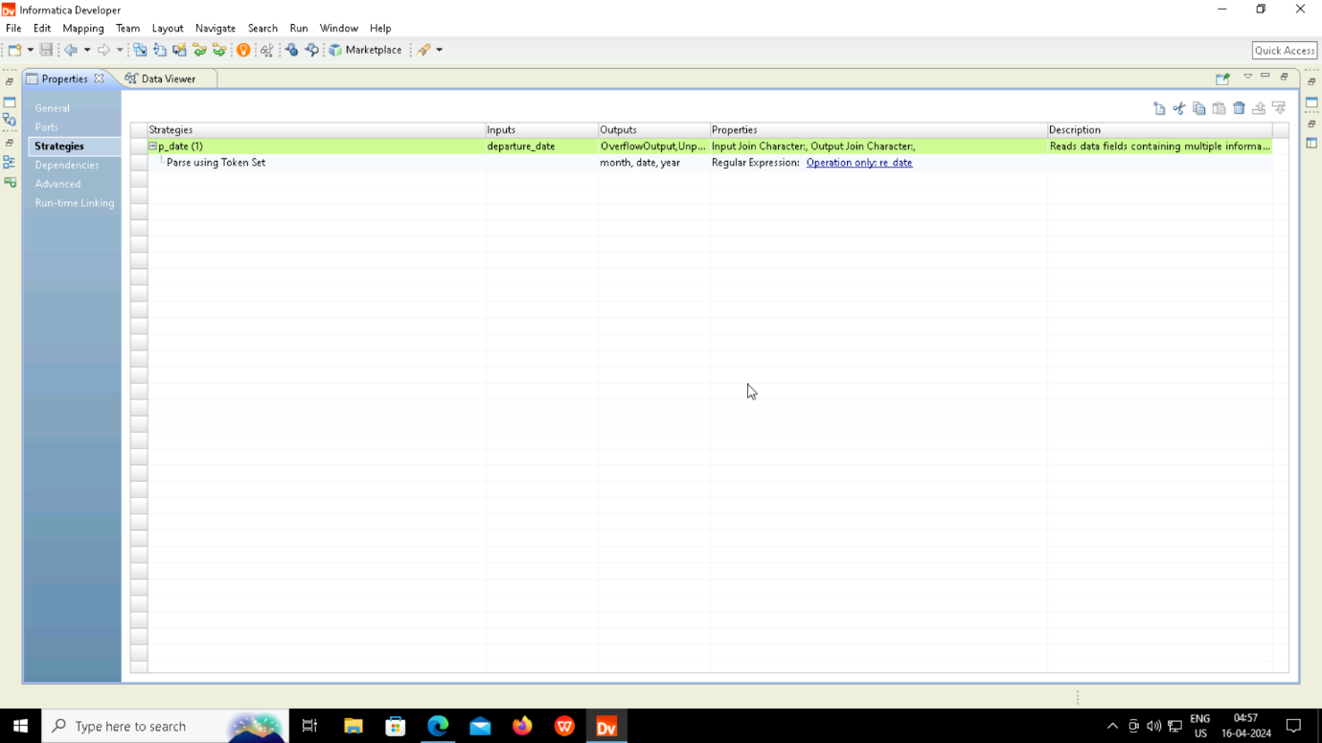

Slide 28
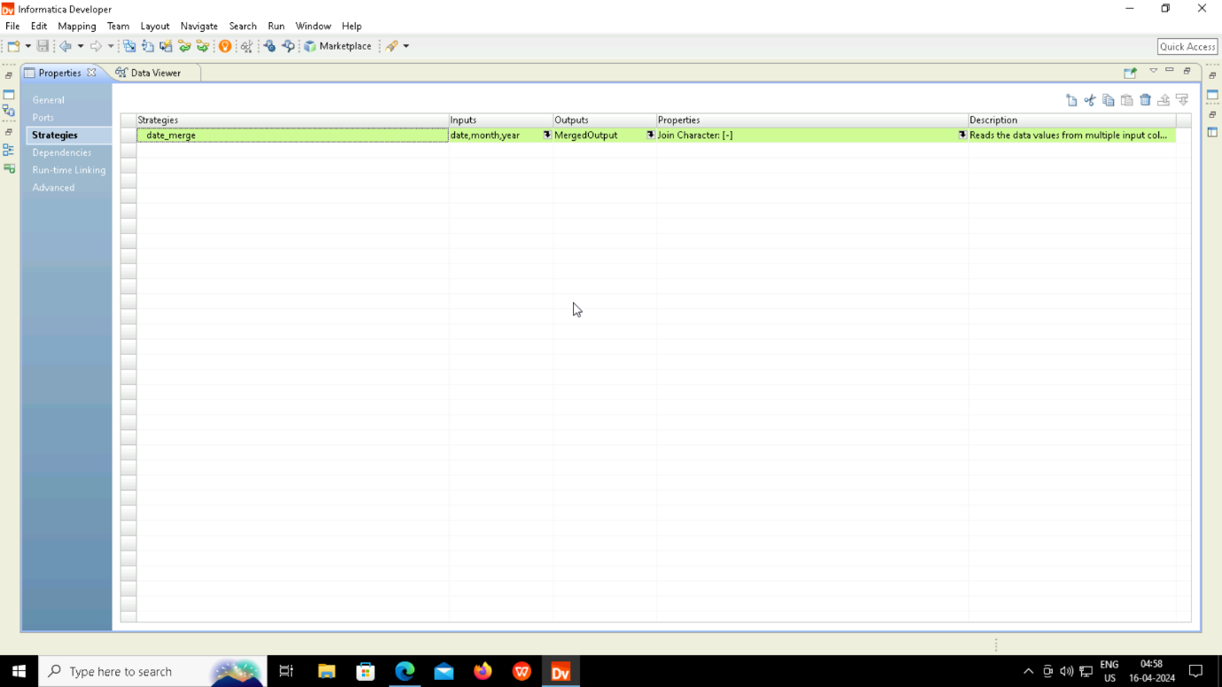

Slide 29
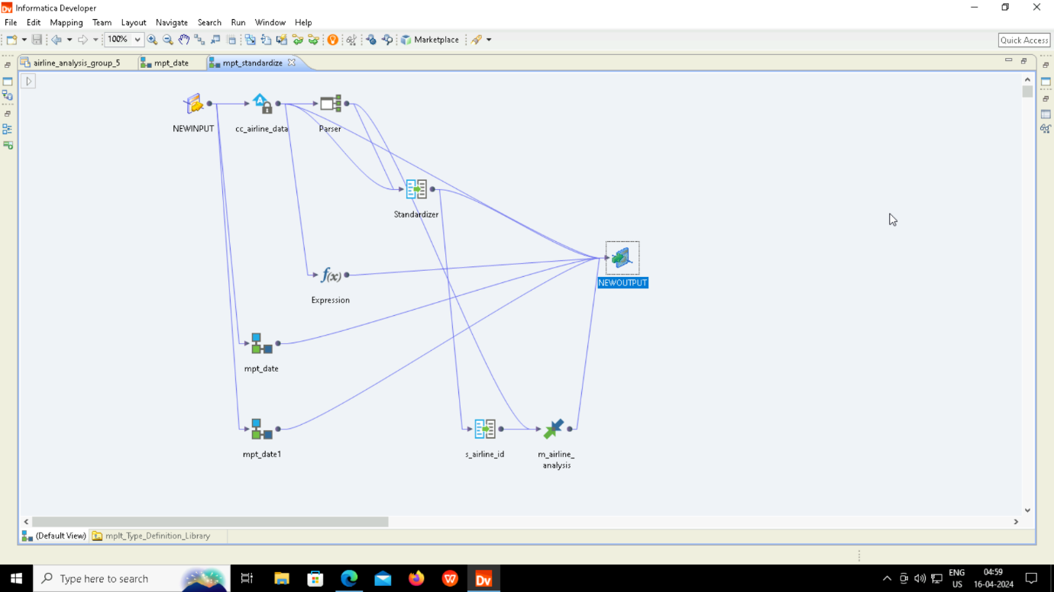

Slide 30
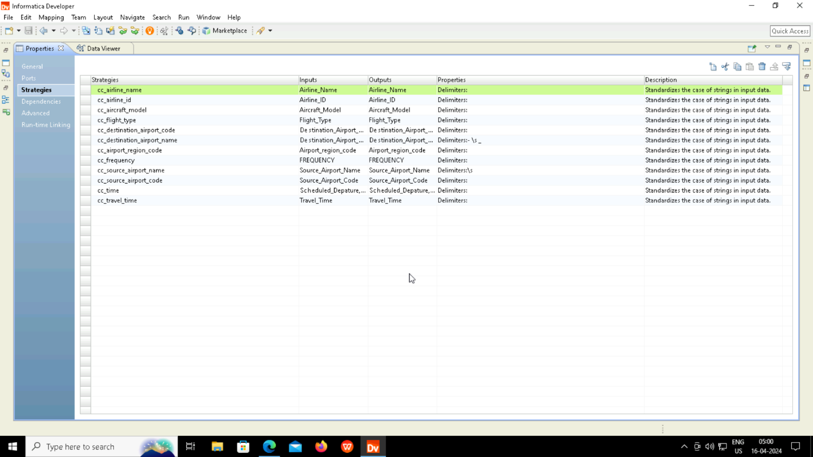

Slide 31
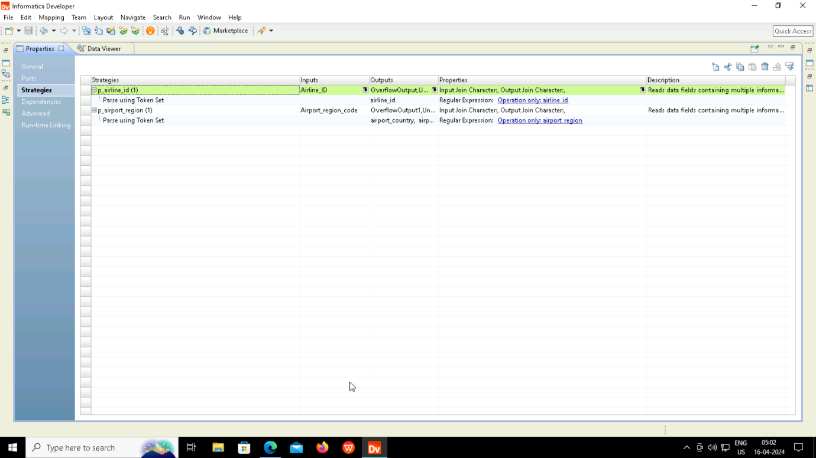

Slide 32
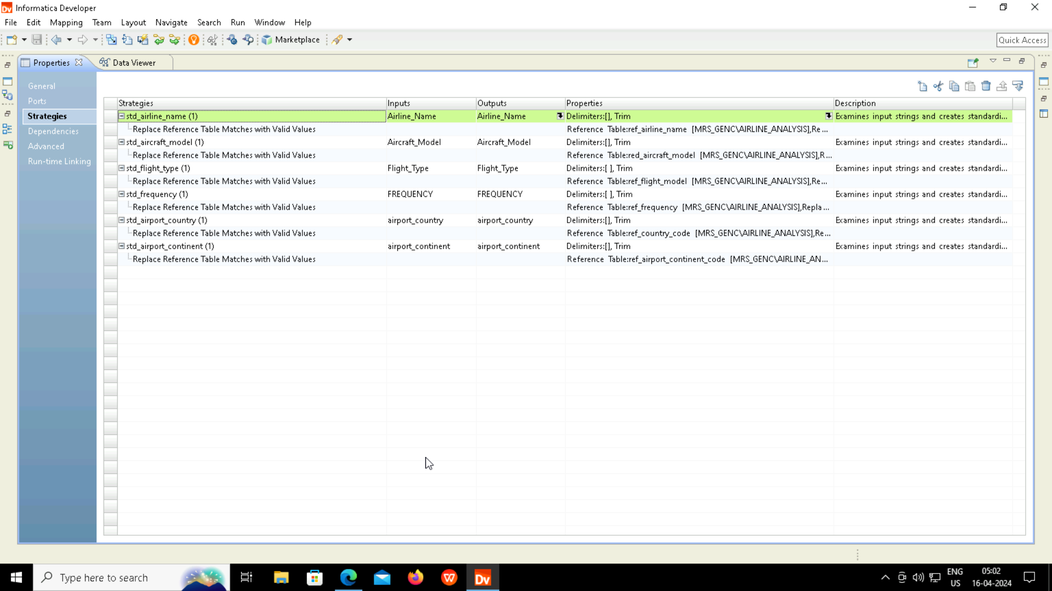

Slide 33
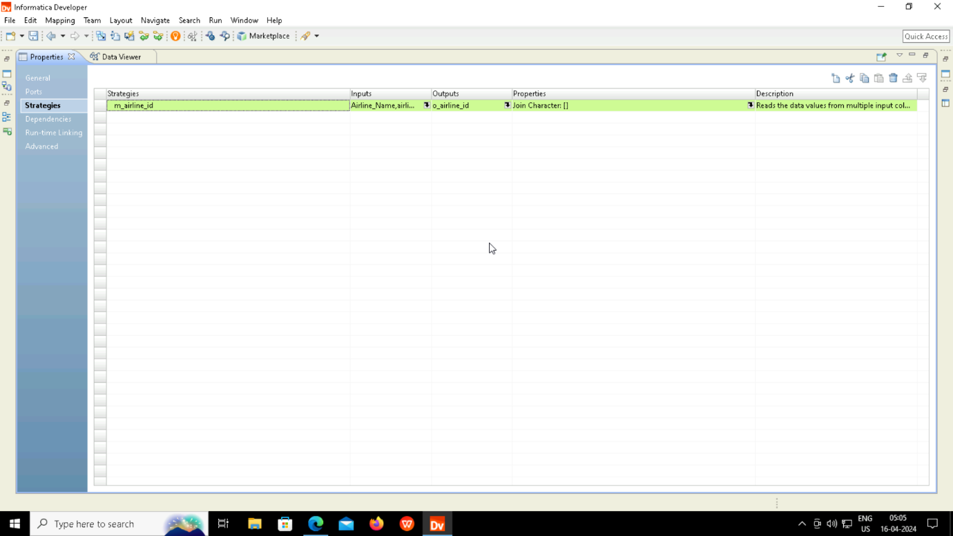

Slide 34
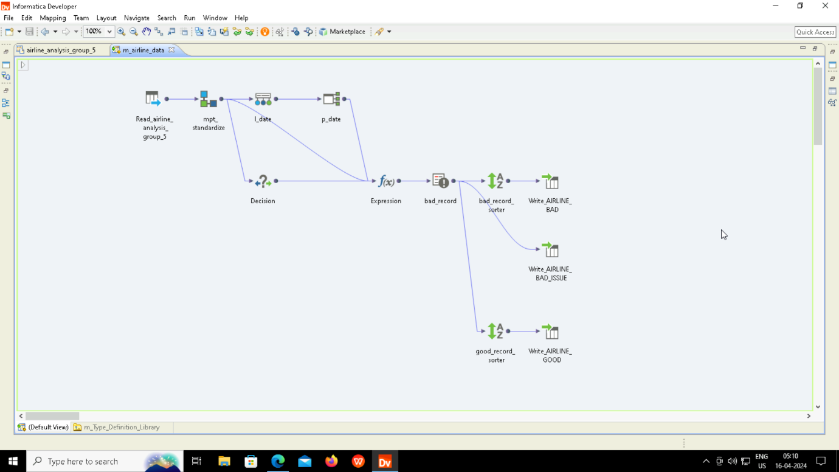
MAPPING

Slide 35
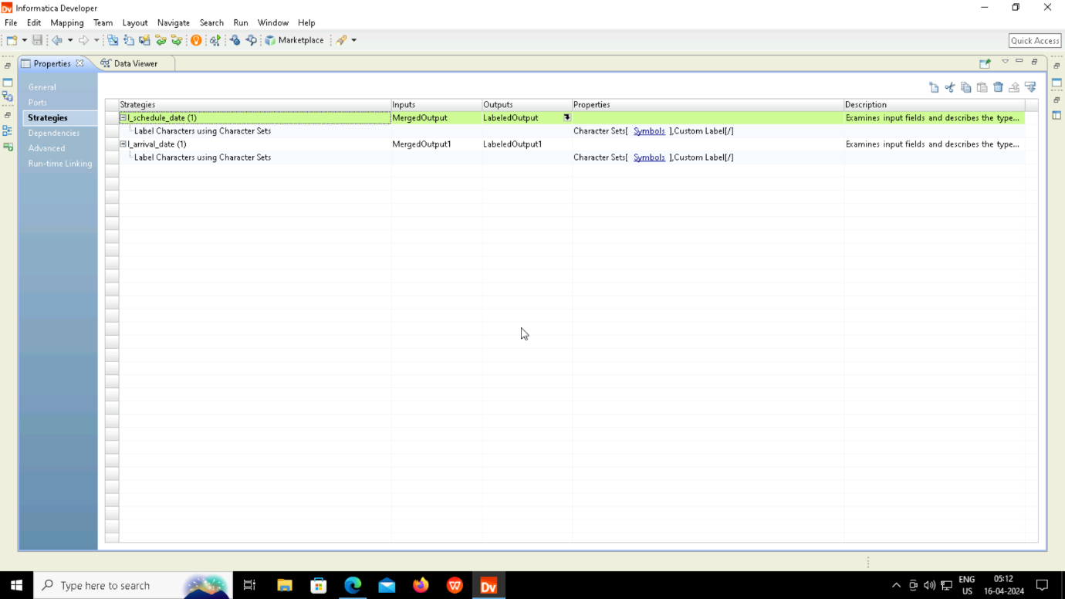

Slide 36


Slide 37
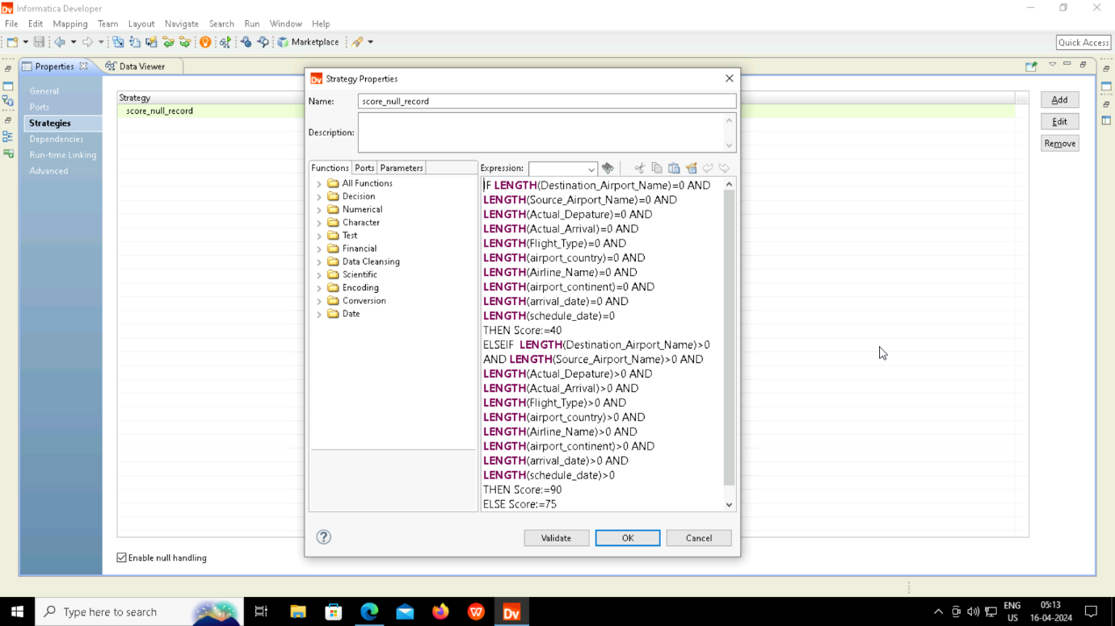

Slide 38
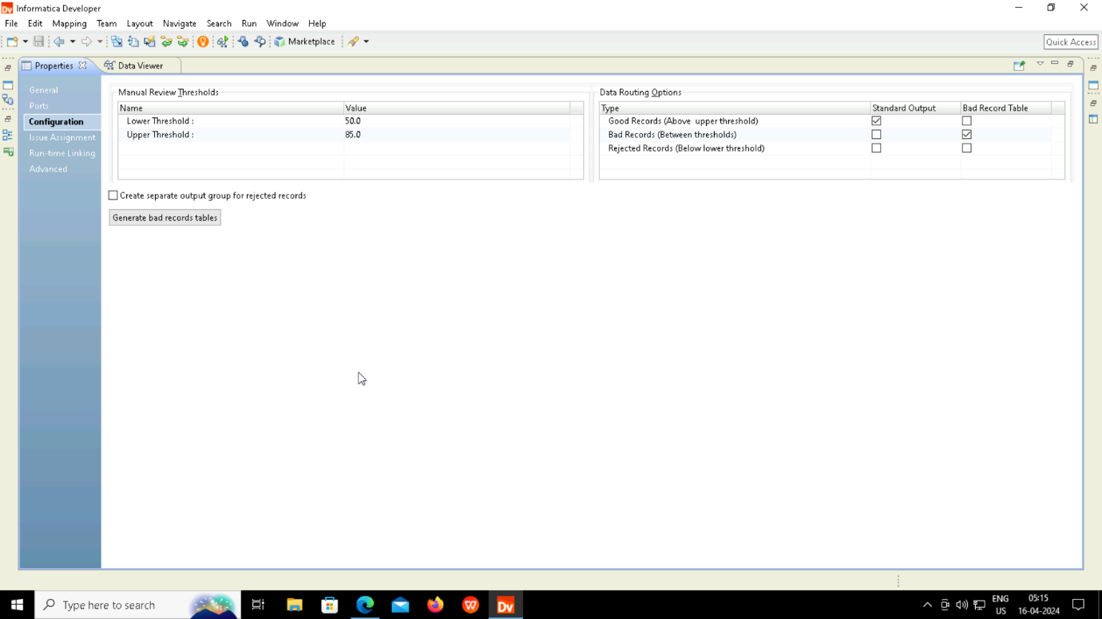

Slide 39
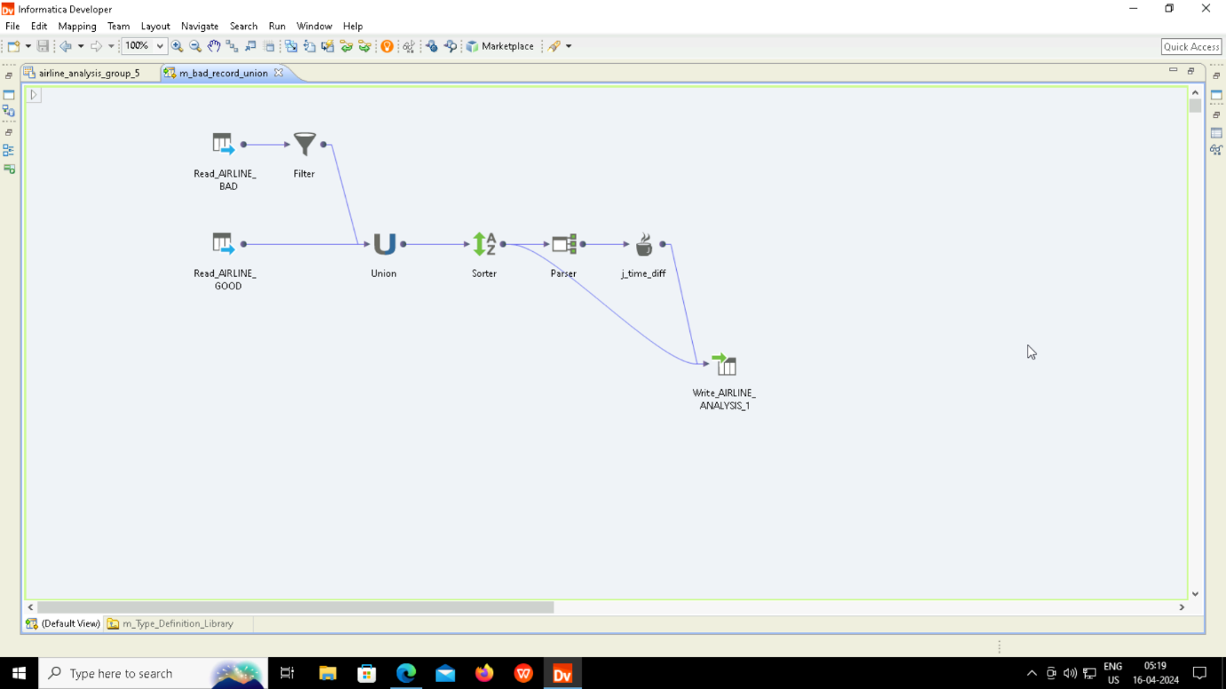

Slide 40
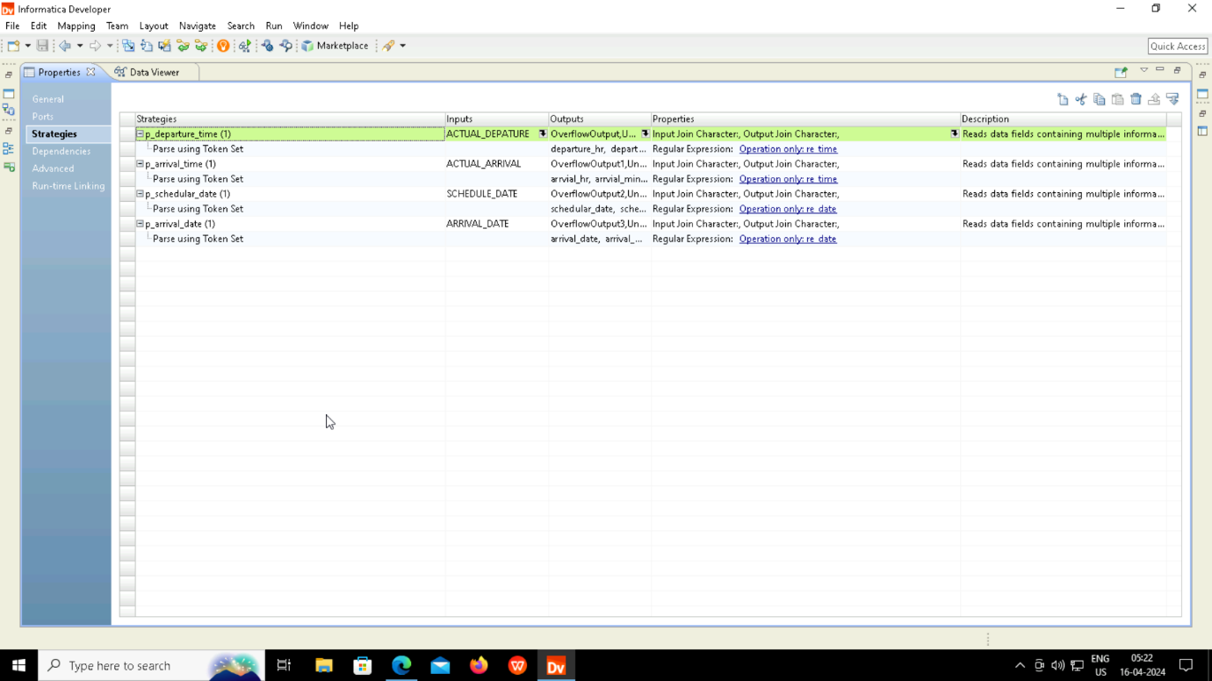

Slide 41
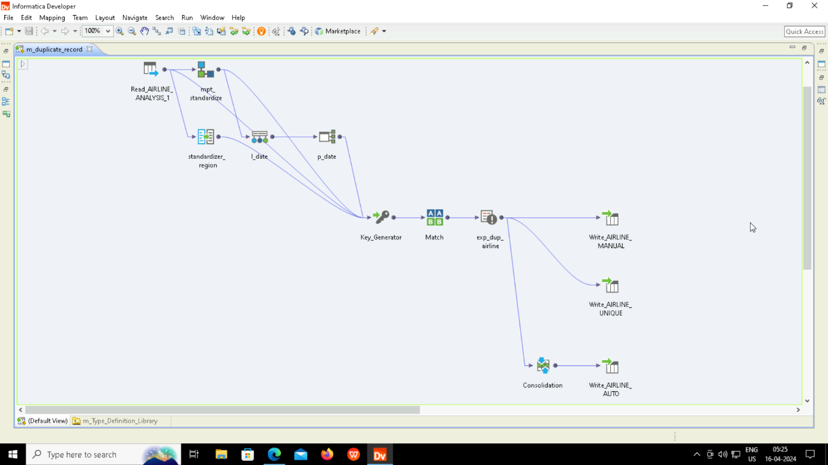

Slide 42


Slide 43


Slide 44
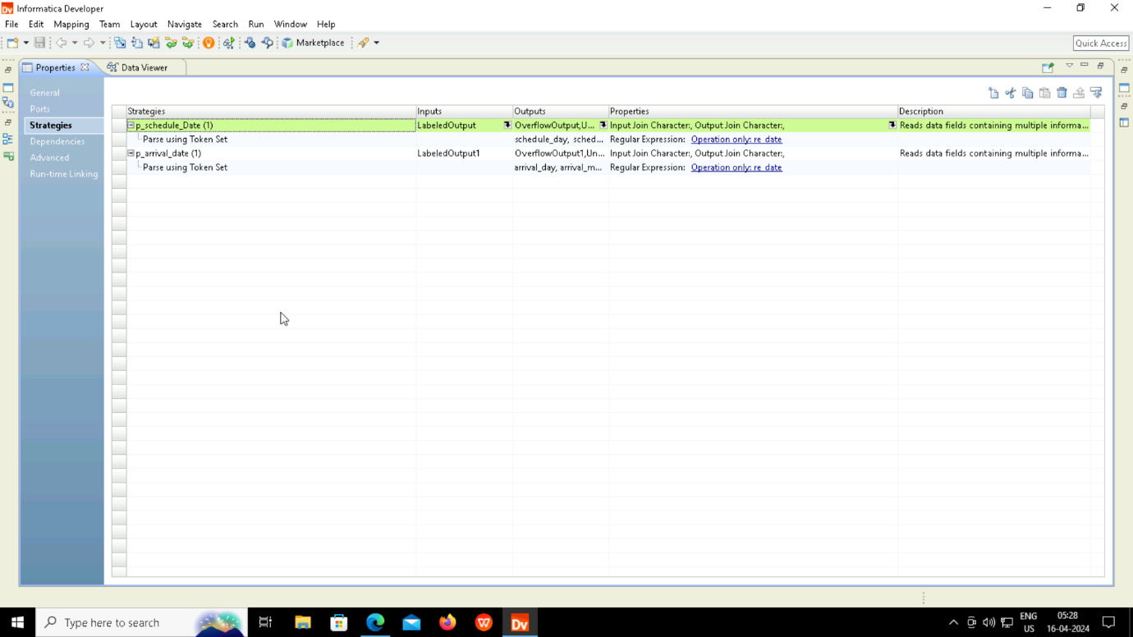

Slide 45
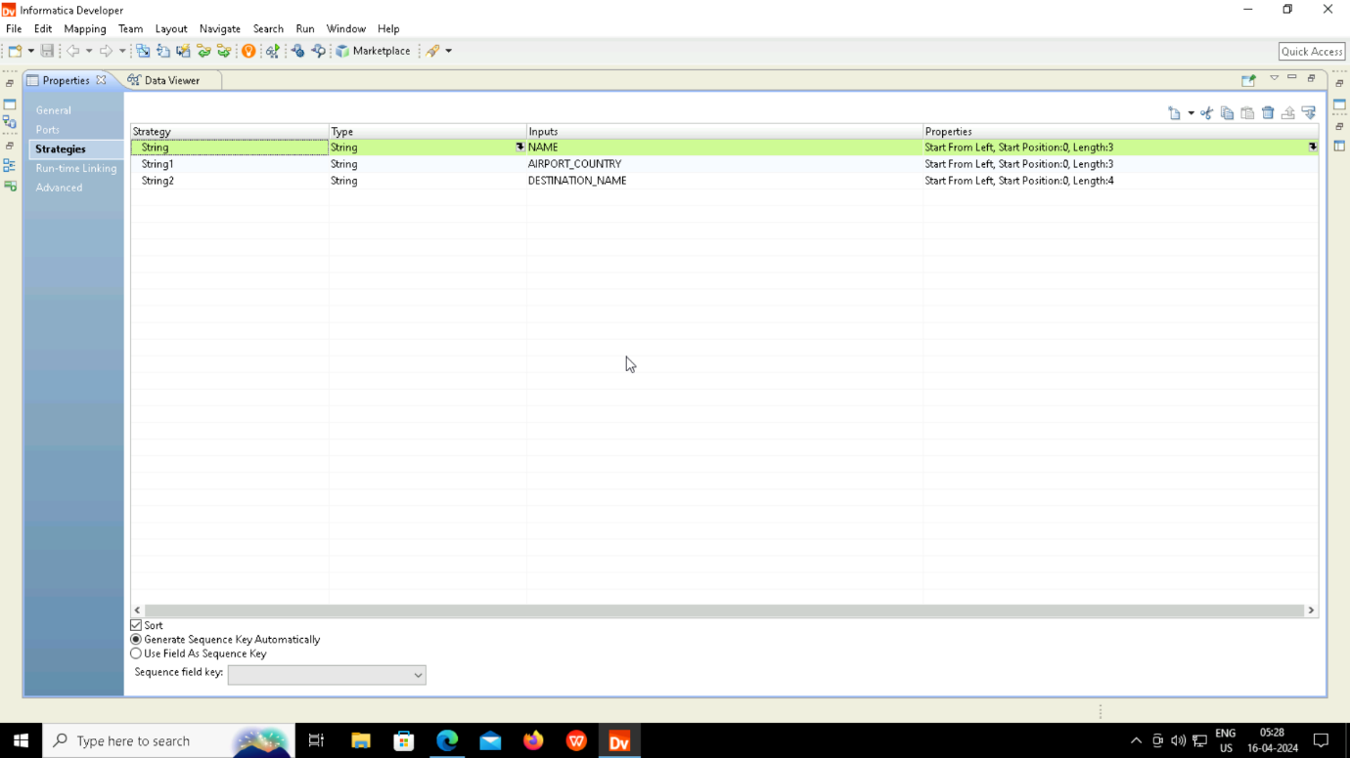

Slide 46
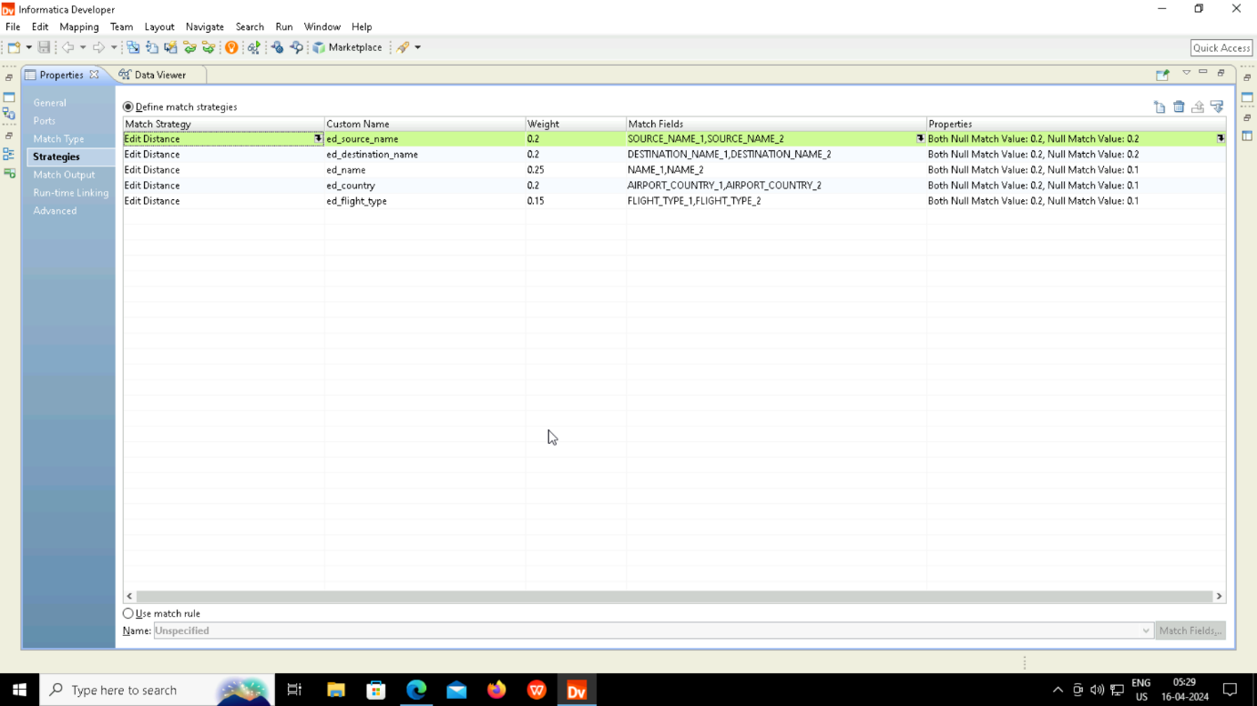

Slide 47
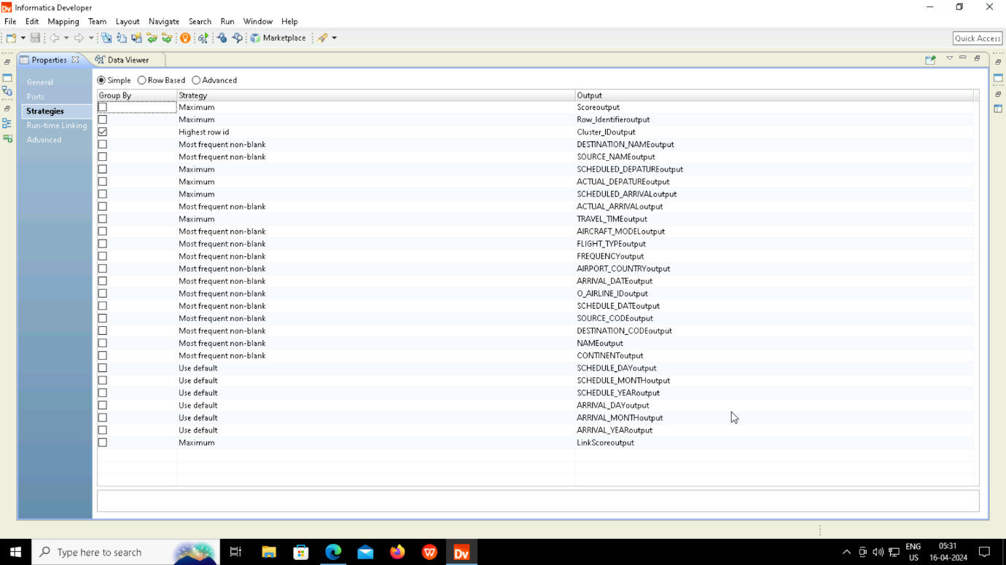

Slide 48
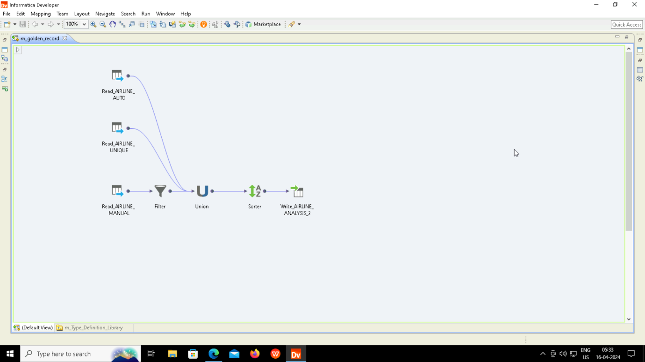

Slide 49
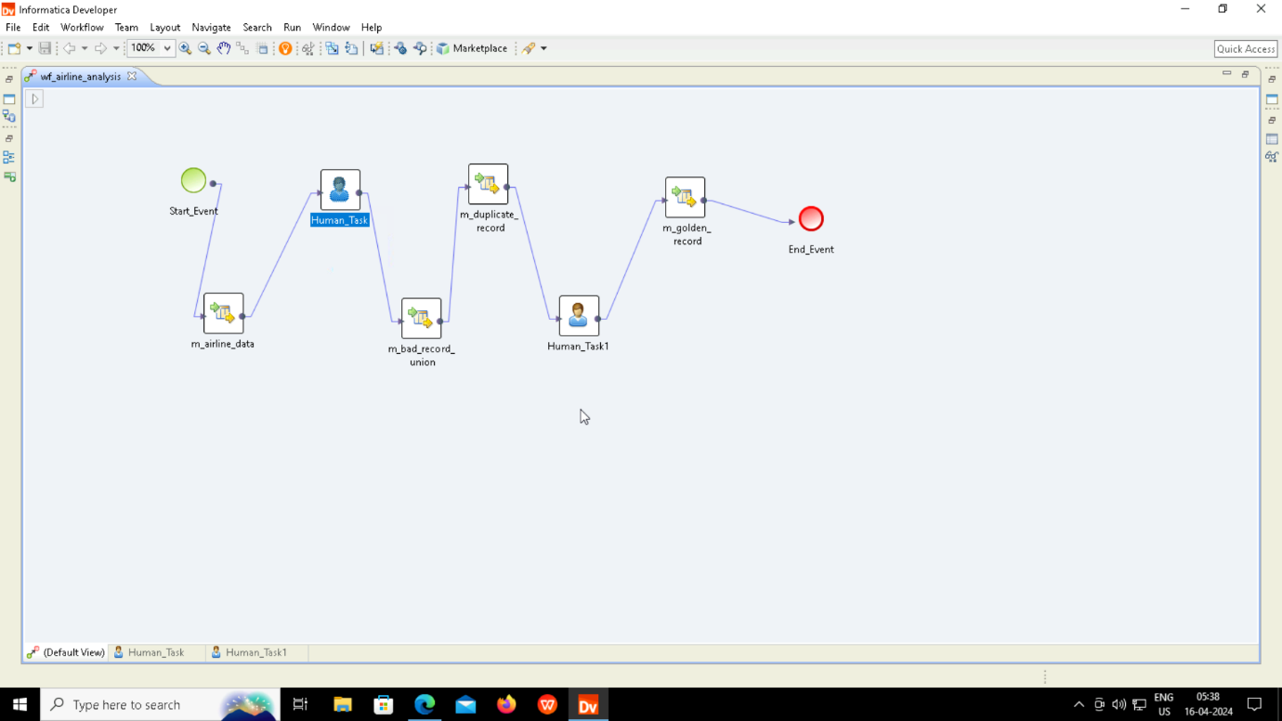
WORKFLOW

Slide 50
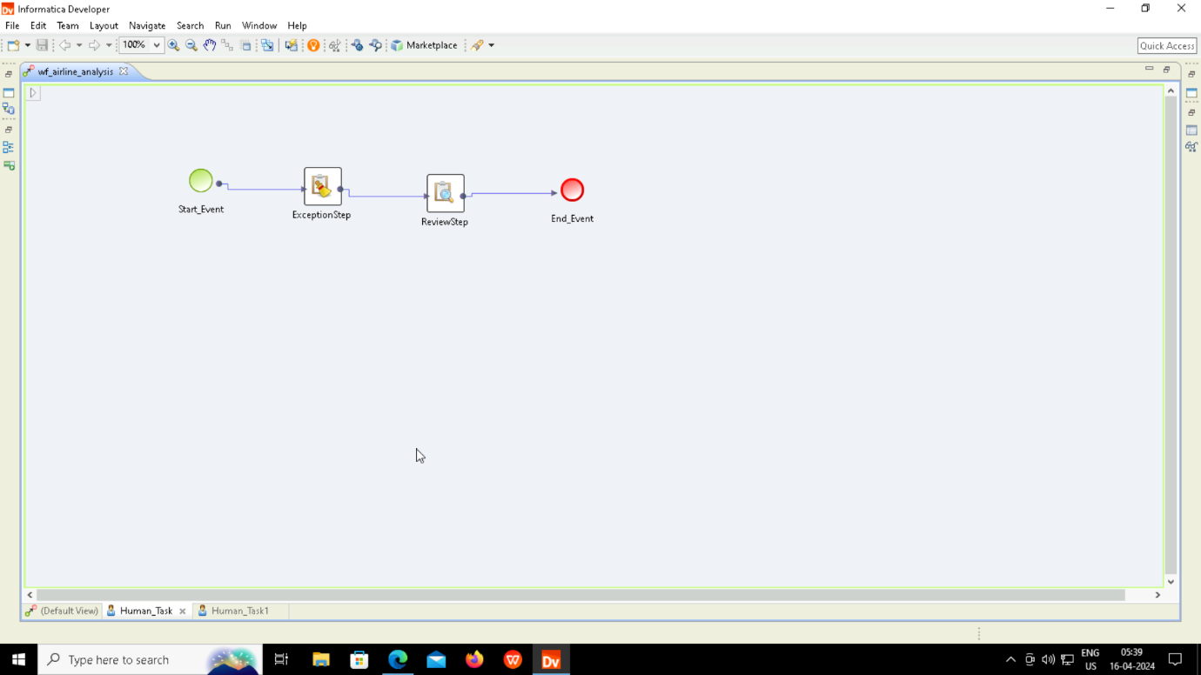

Slide 51
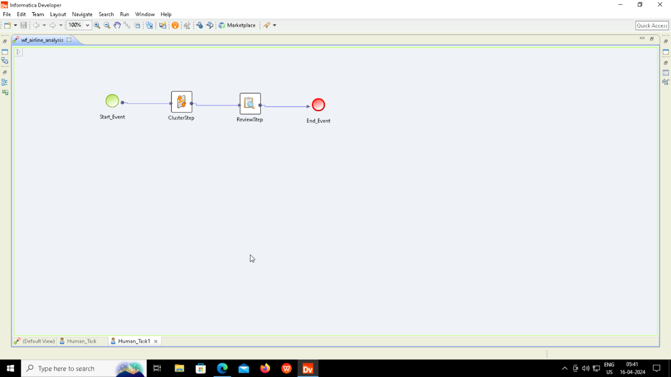

Slide 52
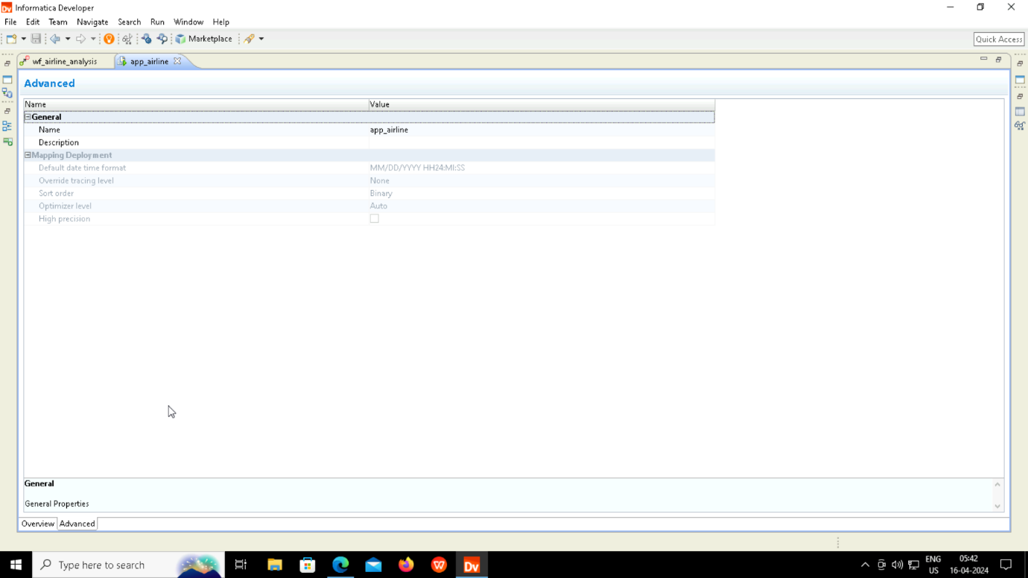
APPLICATION

Slide 53
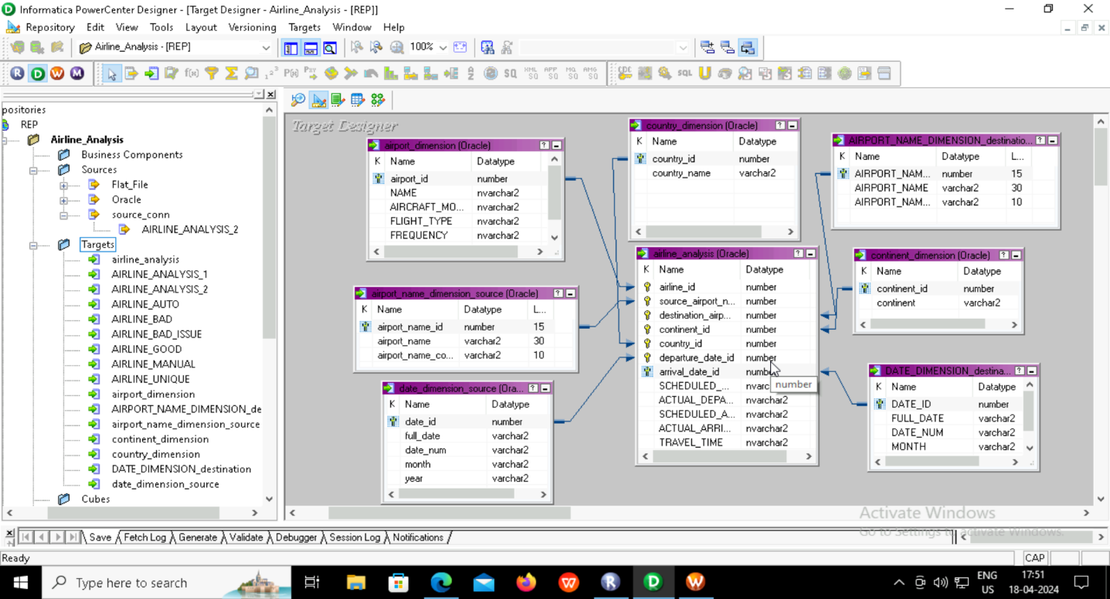
FACT AND DIMENSION

Slide 54
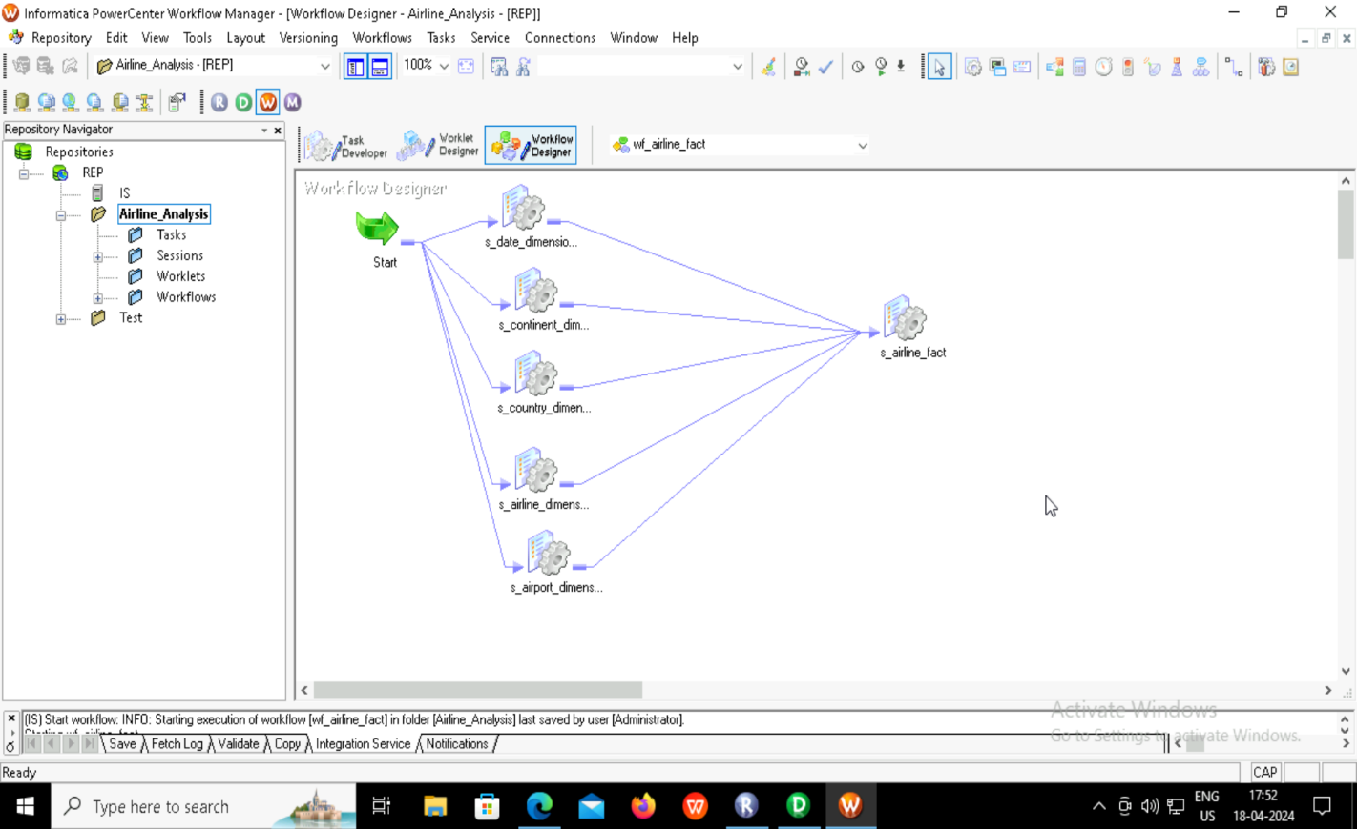
WORKFLOW

Slide 55
CONCLUSION
Our project endeavour’s to revolutionize data quality and integration practices within the airline industry, ultimately aiming to enhance operational efficiency and decision-making processes. By parsing intricate attributes such as airport region and date, we enable granular analysis and anomaly detection, empowering stakeholders with deeper insights into temporal and spatial trends. Additionally, our robust exception handling mechanisms, coupled with standardized representations, ensure data integrity and clarity, laying the foundation for reliable and actionable analytics.

